Slide 1
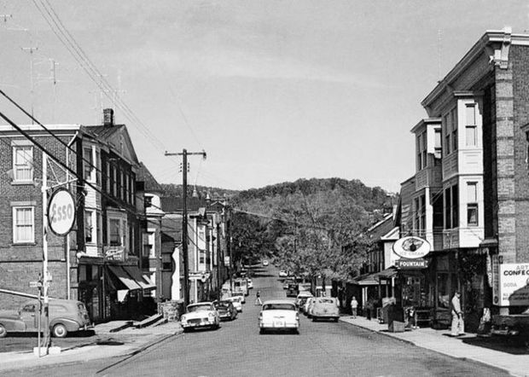
High Bridge School District 2021-2022 Tentative Budget
Dr. Gregory Hobaugh, Superintendent
John Jennings, Business Administrator

Slide 2
Budget Objectives
Maintains programs and supports student achievement.
Addresses wellness and safety needs.
Minimizes tax impact on residents.

Slide 3
2021-2022 Tentative Budget Appropriations
General Fund $9,280,932
Special Revenue $1,098,344
Debt Service $ 531,750
TOTAL 2021-2022 Budget: $10,911,026

Slide 4
2021-2022 Tentative Budget Revenue Sources:
Total Tax Levy | $7,152,466
State Aid incl. debt service | $1,486,722
Budgeted Fund Balance | $ 427,500
PEA Expansion Aid | $ 910,778
Grants | $ 132,462
Capital Reserve Withdrawal | $ 705,104
Other misc. | $ 96,718
Total Revenues | $10,911,026

Slide 5
Capital Project
Middle School Boiler Replacement
Boilers are 60+ years old
Rising maintenance costs
Reliability decreasing
Estimated Cost to replacement
Equipment and installation $600,000
Remediation and other costs $190,383
Architect Fees $ 50,000
Total Budgeted Cost $840,383
Amounts above do no reflect incentive program savings

Slide 6
2021-2022 TAX LEVY Tentative
2020-2021 Tax Levy | 2021-2022 Tax Levy | $ Difference | % Difference
$6,567,650 | $6,699,003 | $131,353 | 2.00%
2020-2021 Debt Service* | 2021-2022 Debt Service* | $ Difference | % Difference
$453,251 | $453,463 | $ 212 | 0.047%
TOTAL TAX LEVY = $7,152,466
OVERALL INCREASE = 1.87%
*Tax levy previously approved by the community through a referendum (1997)

Slide 7
2021-2022 Tentative TAX LEVY
School Year | Average Property Value | Calendar Year Tax Rate | Property Tax (HB schools portion)
21-22 | $229,635 | .021324 | $4,897
Annual Tax Increase on Average Home = $99.60 Or Monthly Increase on Average Home = $8.30

Slide 8
2021-2022Tentative Budget Historical Tax Rate % Increases
School Year | Total Tax Levy | YOY Inc. % | Average Home Value | Per Home Monthly Increase
16-17 Audit | $5,937,817 | N/A | $228,501 | N/A
17-18 Audit | $6,254,228 | 5.33% | $228,221 | $18.56
18-19 Audit | $6,565,706 | 4.98% | $227,040 | $16.35
19-20 Audit | 6,832,760 | 4.07% | $227,380 | $15.45
20-21 Budget | 7,020,901 | 2.75% | $227,737 | $7.06
21-22 Budget | 7,152,466 | 1.87% | $229,635 | $8.30

Slide 9
THANKS!

